Slide 1
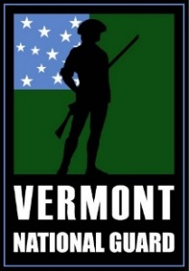
Vermont National Guard Inspector General
An Inspector General is a fair and impartial fact finder who serves as the eyes, ears, voice, and conscience of the Commander
What can the Inspector General do for you?
THE IG IS HERE TO ASSIST WITH:
Requests for policy and regulation information.
Requests for assistance for issues the chain of command has been unable to resolve.
Allegations of impropriety.
Conduct thorough, objective, and impartial inspections and investigations.
Provide assistance and training.
Advise and assist leaders maintain values, readiness, and effectiveness.
THE IG IS NOT:
A substitute for the chain of command. Give your chain the opportunity to resolve your issue first.
An alternative to established redress or appeal processes.
MAJ Kevin Elmer | Inspector General | (O) 802.338.3240 kevin.k.elmer.mil@army.mil
Mr. August Haberstroh | Assistant IG | (O) 802.338.3453 august.f.haberstroh.civ@army.mil
Soldiers, Airmen, and civilian employees have the right to present issues to the IG.

